Slide 1
A core Course on Modeling
Introduction to Modeling
0LAB0 0LBB0 0LCB0 0LDB0
c.w.a.m.v.overveld@tue.nl
v.a.j.borghuis@tue.nl
S.25

Slide 2
Execution phase: operate model
define
formulate
purpose
conceptualize
identify
entities
choose
relations
formalize
obtain
values
formalize
relations
execute
operate
model
obtain
result
conclude
present
result
interpret
result
Notes:
2

Slide 3
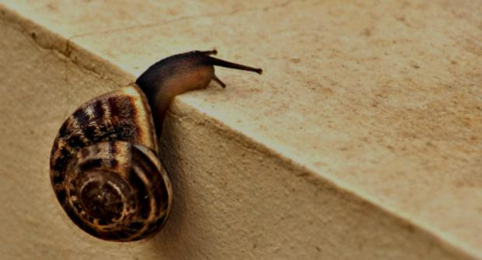
Evolutionary methods to approximate Pareto front
Trade-offs and the Pareto front
We should find ‘good’ or even ‘best’ concepts in cat.-I space.
Mathematical optimization only works for single-valued functions;
Approach: gradually climbing upward to a slope surface;
This would apply to a single cat.-II quantity, or all cat.-II quantities lumped;
We seek something more generic.
http://www.morguefile.com/archive/display/233348
Notes:
3

Slide 4
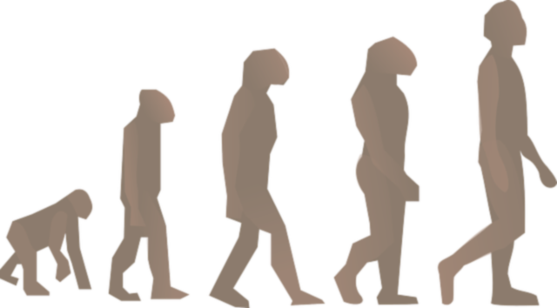
Evolutionary methods
Idea (Eckart Zitzler): combine Pareto and Evolution.
Main features of evolution:
genotype encodes blueprint of individual (‘cat.-I’);
genotype is passed over to offspring;
new individual: genotype → phenotype, determining its fitness (‘cat.-II’);
http://www.clipartlord.com/wp-content/uploads/2013/06/evolution.png
Notes:
4

Slide 5
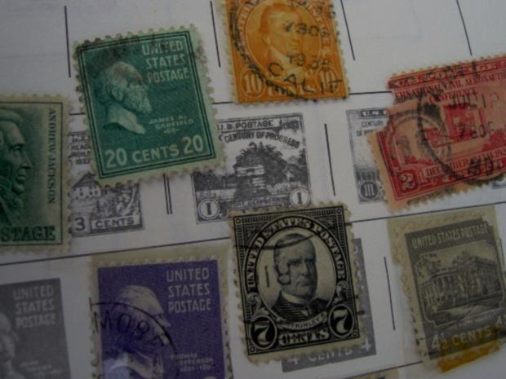
Evolutionary methods
variations in genotypes (mutation, cross-over) cause variation among phenotypes;
fitter phenotypes have larger change of surviving, procreating, and passing their genotypes on to next generation.
http://www.morguefile.com/archive/display/606445
Notes:
5

Slide 6
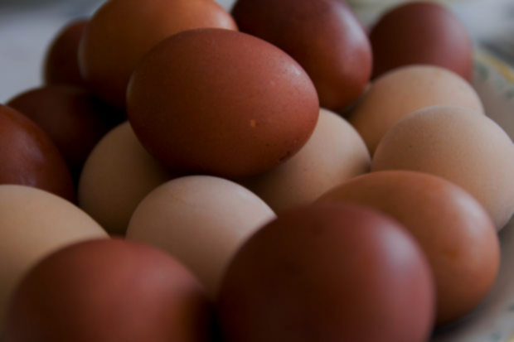
Evolutionary methods
Issues to resolve:
How to start → population of random individuals (tuples of values for cat.-I quantities);
How to define fitness → fitter when dominated by fewer;
Next generation → preserve non-dominated ones; complete population with mutations and crossing-over;
Convergence → if Pareto front no longer moves.
http://www.morguefile.com/archive/display/672384
Notes:
6

Slide 7
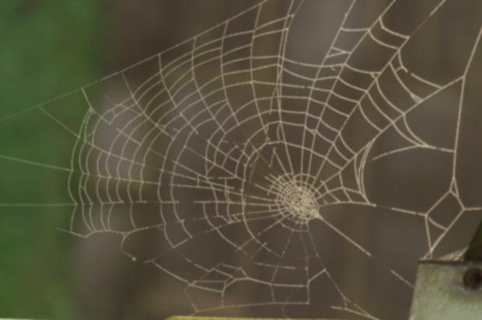
Evolutionary methods
Caveats: Pareto-Genetic is not perfect
http://cdn.morguefile.com/imageData/public/files/j/jusben/preview/fldr_2008_11_17/file000612131406.jpg
Notes:
7

Slide 8
Evolutionary methods
Caveats: Pareto-Genetic is not perfect
QUIZ
What would happen if there are very few dominated solutions in cat.-II space?
http://cdn.morguefile.com/imageData/public/files/j/jusben/preview/fldr_2008_11_17/file000612131406.jpg
Notes:
8

Slide 9
Evolutionary methods
Caveats: Pareto-Genetic is not perfect
If the fraction non-dominated concepts is too large, evolution makes no progress;
If there broad niches, finding individuals in a narrow niche may be problematic;
Approximations may fail to get near the theoretical best Pareto front.
http://cdn.morguefile.com/imageData/public/files/j/jusben/preview/fldr_2008_11_17/file000612131406.jpg
Notes:
9

Slide 10
Evolutionary methods
Caveats: Pareto-Genetic is not perfect
(No guarantee that analytical alternatives exist)
DON’T use Pareto-Genetic if guarantee for optimal solution is required.
Notes:
10

Slide 11
Evolutionary methods
demo
Notes:
11

Slide 12
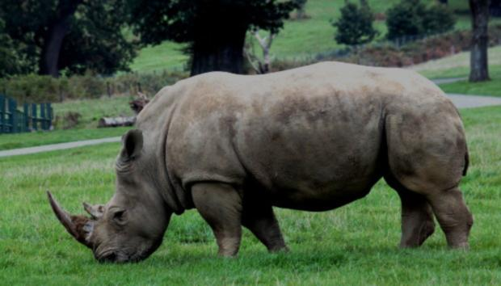
Evolutionary methods
If anything else fails:
Complementary approach: local optimization (to be applied on all elements of the Pareto-front separately);
Split cat.-I space in sub spaces if model function behaves different in different regimes (e.g., too much cat.-I freedom may lead to bad evolution progress);
Temporarily fix some cat.-IV quantities (pretend that they are in category-III).
http://www.morguefile.com/archive/display/708871
Notes:
12

Slide 13
Summary
functional model helps distinguish input (choice) and output (from purpose);
Building a functional model as a graph shows roles of quantities. These are:
Cat.-I : free to choose;
Models for (design) decision support: the notion of design space;
Choice of cat.-I quantities: no dependency-by-anticipation;
Cat.-II : represents the intended output;
The advantages and disadvantages of lumping and penalty quantities;
The distinction between requirements, desires, and wishes;
The notion of dominance to express multi-criteria comparison; Pareto front;
Cat.-III : represents constraints from context;
Cat.-IV : intermediate quantities;
For optimization: use evolutionary approach;
Approximate the Pareto front using the SPEA algorithm;
Local search can be used for post-processing.
Notes:
13

